Slide 1
2018 Citi Bike Analysis
John Giglio

Slide 2
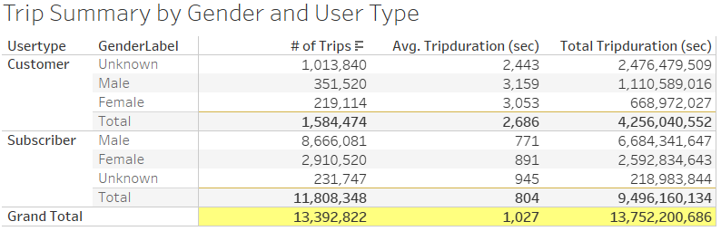
2018 YTD Rides
2018 YTD there have been over 13 million trips by Citi Bike users. The average trip lasts approximately 17 minutes.
Of those reporting gender, Male riders have accounted for more trips and longer total ride time.
Subscribers have taken far more rides in 2018, but day-pass customers ride for more than 3 times longer on each trip.

Slide 3
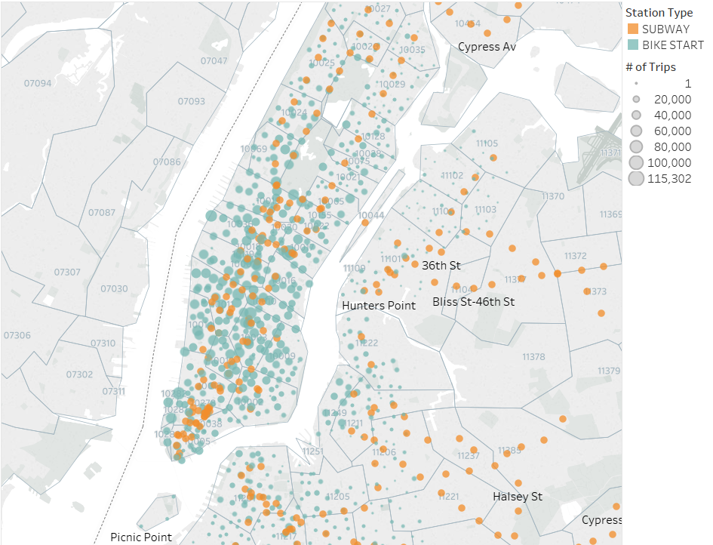
Trip Starting Locations
The stations in Manhattan are more popular for stating trips than those in Queens and Brooklyn.
Many of the most popular stations for starting trips are located near subway stations.

Slide 4
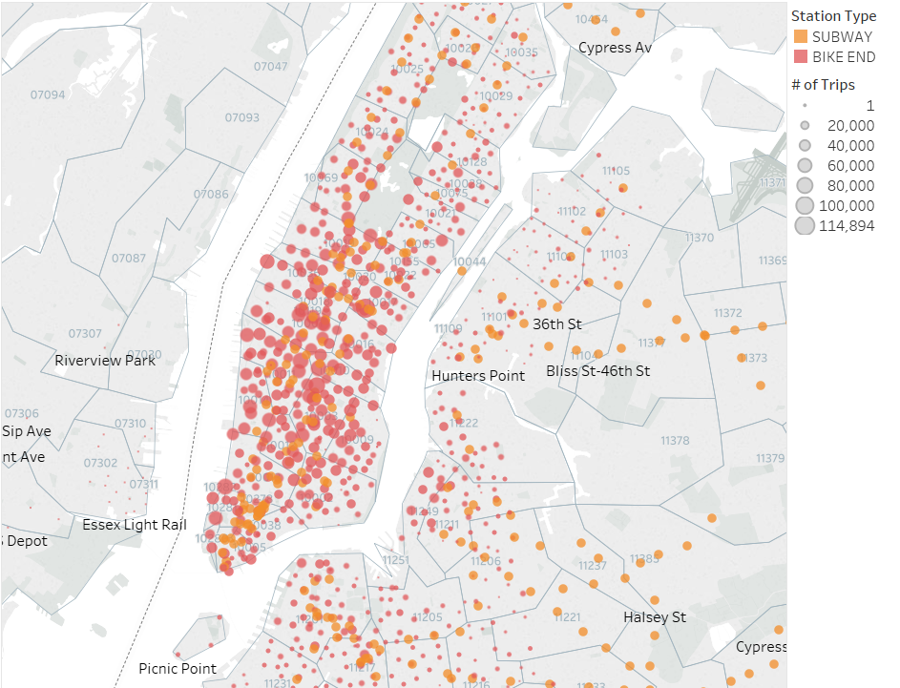
Trip Ending Locations
Trip End stations show a pattern similar to the Trip Start stations.
Citi Bike should consider increasing their marketing efforts on trains that go to and from Queens and Brooklyn as well as in the subway stations that are located near the under-performing Citi Bike stations.

Slide 5
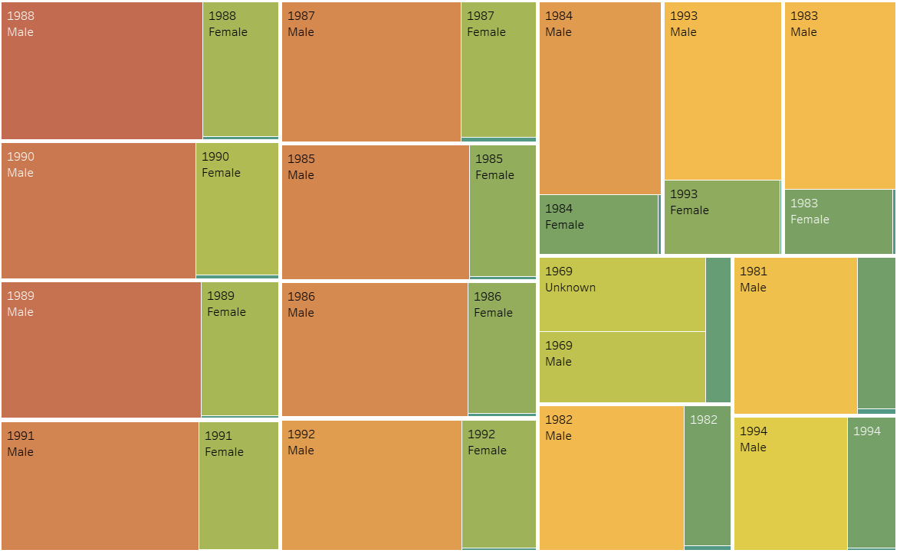
Top 15 Subscriber Birth Years
14 of top 15 Subscriber birth years (by number of trips taken) are 1981 - 1994
1969 is the only birth year in the top 15 that is not within the above range
Males account for the majority of rides by each birth year, except for 1969, which has a large number of unknown gender.

Slide 6
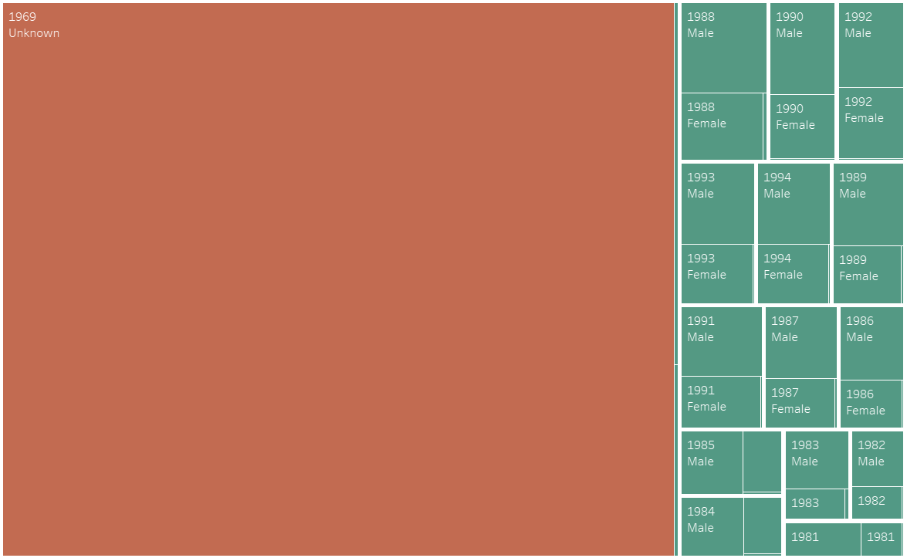
Top 15 Day-Pass Customer Birth Years
The majority of Day-Pass customers have a birth year of 1969 and did not report their gender.
It is assumed that these are default settings for new Day-Pass customers.

